Slide 1
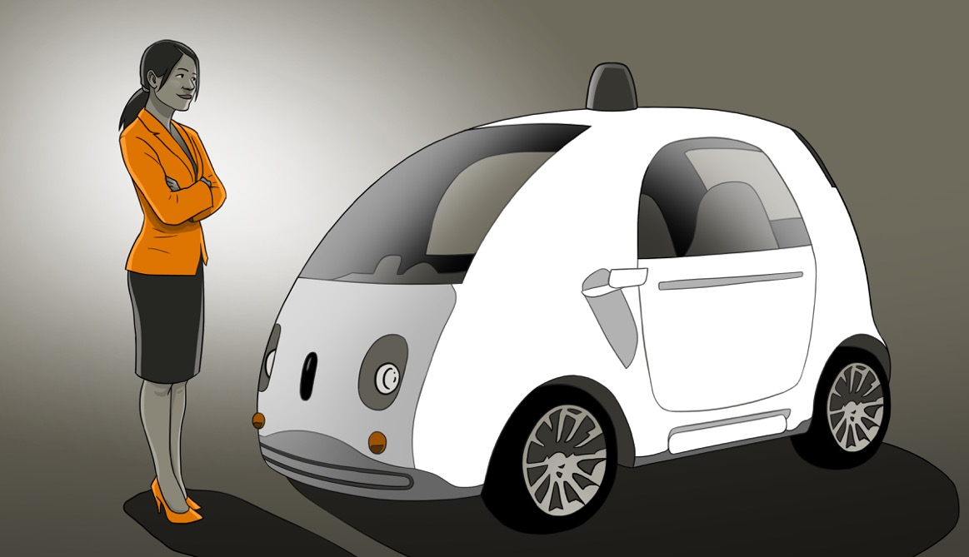
The Disruption of Mobility on Demand
NAMVBC Fall Workshop
Sept 16, 2016 Denver, Colorado
Notes:
My education is in geophysics, but most of my life I’ve been an
entrepreneur and venture capitalist. Sold a co 3 years ago: non-compete.
DI research convinced me to write my e-book, Driverless Car Revolution
It was published almost a year and a half ago, and it is amazing to see the
changes since then.
Automakers business models have always been based on selling cars.
That seems to be changing.

Slide 2
KPMG Global Survey, 800 auto executives
How likely is a major business model disruption in the next five years?
2015: 12%
2016: 82%
1%
Notes:
How fast are things changing?
One of the Big 4 Auditors (KPMG, Deloitte, EY and PwC)
Emphasize that this is a Global Executive survey, not just USA

Slide 3
KPMG Survey: Most likely business models by 2025
Source: KPMG’s Global Automotive Executive Survey 2016
Notes:
No value is put on savings due to no parking, useful time in the vehicle, fewer accidents
Consumer Reports vehicle cost was adjusted down assuming $2.27 per gallon gasoline.

Slide 4
Ford CEO Mark Fields: Reposition Ford as a “mobility company” and not just a carmaker
Source: Paul A. Eisenstein, The Detroit Bureau, Jan 19 2016
Notes:
People don’t need a new car every day, but they need mobility every day.

Slide 5
Automakers: Car sales or mobility services?
Ford:
$4.5 billion investment in electrified vehicle solutions
Ford Smart Mobility LLC: Car sharing & “Uber cloning”
GM:
$1 billion acquisition of Cruise Automation
$500 million to buy 10% of Lyft
Daimler: $100 MM for RideScout, VW $300 MM into Gett, Apple $1B into Didi Chuxing, Uber $680 MM for Otto
Notes:
Ford CEO Mark Fields
Didi Chu-shing

Slide 6
Will Consumers buy Mobility or Metal? Mobility on Demand: “RoboTaxis” and Driverless Carpools
Notes:
People don’t need a new car every day, but they need mobility every day.
You decide for yourselves whether major changes are ahead.

Slide 7
RoboTaxis: Think Uber on steroids
Electric RoboTaxis:
28¢/mile (2 seats), 14¢/mile (ridesharing)
40¢/mile (4 seats + child seat, bike rack, storage)
at a 35% pre-tax profit for the operator
Barclays Capital: 8¢/mile, Colombia Univ: 13¢/mile
Each RoboTaxi replaces 7+ privately-owned cars
Sources: Barclays Capital, May 2015; Columbia Univ, Jan 2013
Notes:
GM / Ford: $150 B 2015 revs
Personal vehicles: parked 95% time
Falling cost of batteries & sensors
RoboTaxi speaks English, Spanish…

Slide 8
RoboTaxi service value proposition
Half to a fourth the cost of owning a car
Faster commutes, less congestion, less pollution
Safe, efficient transportation
No parking or vehicle ownership hassles
Low-stress door-to-door service while you work, read, relax

Slide 9
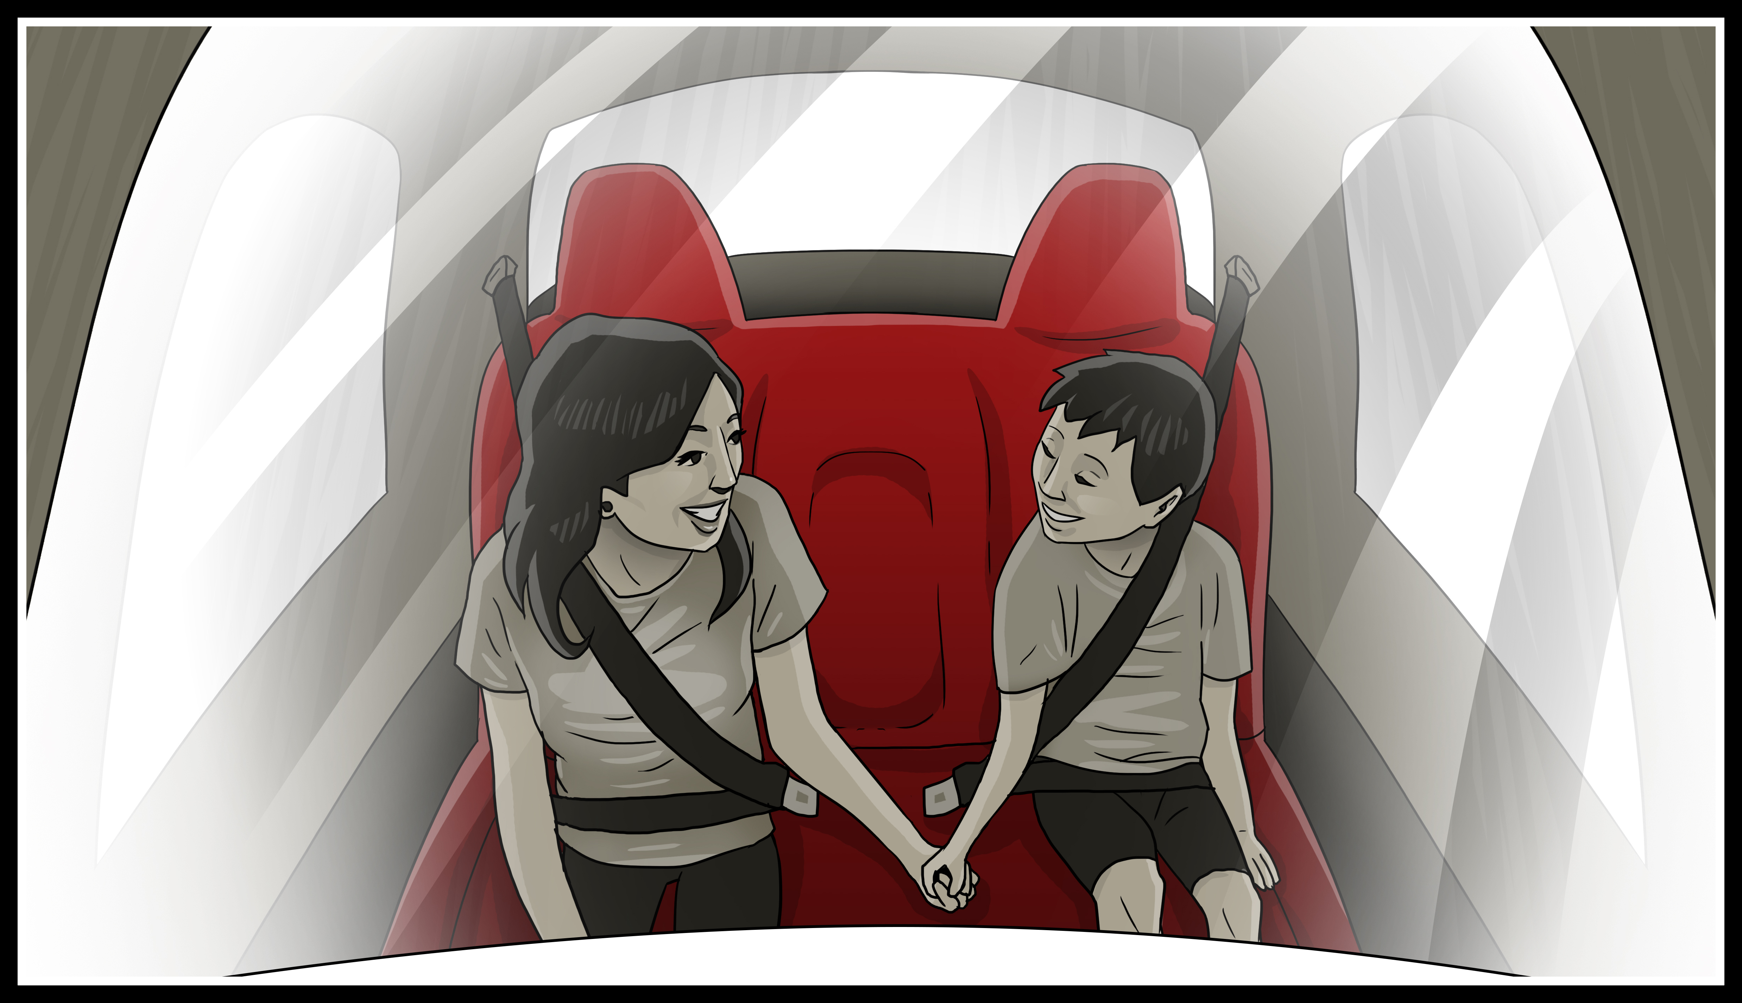
First ride: The Google Car prototype
Notes:
I own no stock in Google!
But Google is the leader in driverless technology

Slide 10
Economics drives adoption: Cost per 12,000 miles
Sources: U.S. Census Bureau, Consumer Reports, Driverless Car Revolution (35% pre-tax profit)
Notes:
No value is put on savings due to no parking, useful time in the vehicle, fewer accidents
Consumer Reports vehicle cost was adjusted down assuming $2.27 per gallon gasoline.

Slide 11
Why RoboTaxis matter: Average family budgets
Transportation is the second-largest drain on a family’s disposable income
36%
Other
13%
Food
19%
Transportation
Source: Federal Highway Administration
Notes:
This is a lot to pay for a resource that sits parked 95% of the time!
For some people, owning a beautiful car is an expression of their personality.
But a lot of people just want to get from Point A to Point B.

Slide 12
How important is safety?
35,092 fatalities in 2015 / 4.4 million injuries
Imagine 250 Boeing 737 crashes a year w/ no survivors
94% of accidents are due to distraction, drowsiness, drunkenness, or driver error
Driverless cars don’t suffer much from those problems
Sources: NHTSA, National Safety Council, Wikipedia
Notes:
The carnage on our highways is a national disgrace. Globally, over a million people die every year.

Slide 13
Will RoboTaxis be safe?
Google driverless road tests : 7 years, 1.97 million miles
23 minor accidents (18 rear-enders), one minor injury
Google at fault only once
software fix in all vehicles within 2 weeks
Notes:
NHTSA: 55% of accidents are not reported
There wasn’t a full turn lane, so instead of blocking traffic most cars squeezed over
The Trolley Problem: Who to kill?

Slide 14
Google’s only accident with an injury
Notes:
At-fault driver was going 17mph (worst accident)
You can see the challenge this documentation of accidents might create for some personal injury attorneys.

Slide 15
What about the Tesla’s fatal crash?
Level 3 autonomy = Tesla Autopilot
Level 4 autonomy = Driverless
Notes:
WSJ: Reports from the accident scene in Florida suggest that the driver may have
been watching a “Harry Potter” movie on a portable DVD player at the time.
Tesla drivers have logged 130 million miles using Autopilot. Most love it.
Musk claims new software release probably would have prevented this crash

Slide 16
Who benefits the most from RoboTaxis?
The public ($$$, free time, safety, congestion)
Taxpayers and government (road expansions)
The environment (cleaner/greener cities)
Developers, seniors, disabled, low income, …
Notes:
Affordable close-in housing, sidewalk cafes
50% US market: REVS=$400 B, and consumer savings of about $600 B
Google 2015 REV=$75B, $15B

Slide 17
Parking: Re-use of space
Personally-owned vehicles sit parked 95% of the time
A billion parking spaces for 253 million vehicles
31% of downtown cores are parking
Sources: UC Berkeley: Parking Infrastructure and the Environment, New Republic
Notes:
Size of Connecticut!

Slide 18
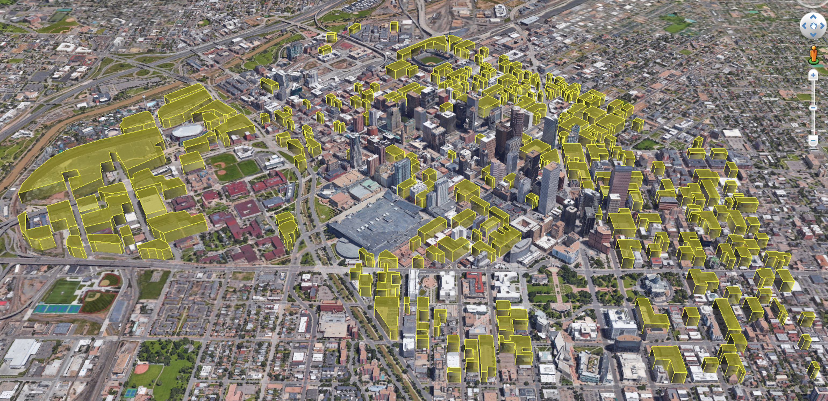
237 acres is lost to parking: surface lots & garages
DENVER
The Evolution of Public Transit
Image courtesy of Ryan Keeney,
University of Denver
Illustration by Stephanie Davidson
Notes:
17% of surface area, Does not include
street parking or integrated office building parking

Slide 19
Who is most at risk?
Automakers, dealers, suppliers, …
The global oil industry
The auto insurance industry
Local bus transit
Parking lots, car rental, taxis, EMT’s, …
Notes:
This isn’t just a happy tale about how wonderful life will be when we have RoboTaxis.
There will also be substantial disruptions of our economy…

Slide 20
New car and truck sales
One RoboTaxi displaces 7+ privately-owned cars
Families replace “second” car with RoboTaxis
More leases aren’t renewed (again, RoboTaxis)
Flood of displaced cars depresses new car sales
Notes:
Personally-owned vehicles are usually parked about 94% of the time

Slide 21
Automotive market strengths vs. RoboTaxis
Primary family vehicle (4 to 7 passengers, “my stuff”)
Pickup’s / SUV’s / service vans (“my stuff”)
Luxury and performance car markets
an expression of the owner’s personality
Driverless heavy duty trucks (Class 8, delivery, etc)
Driverless Class 8: Daimler, Volvo, Otto, Peloton
Notes:
GM / Ford: $150 B 2015 revs
Personal vehicles: parked 95% time
Falling cost of batteries & sensors
RoboTaxi speaks English, Spanish…

Slide 22
New dealership opportunities
Dealerships operate RoboTaxi franchises
Management / maintenance of RoboTaxi fleets
Tires, brakes, repairs, sensor upgrades
Charging, storage, and cleaning of vehicles
Interior retrofit after 250,000 miles
Notes:
Personally-owned vehicles are usually parked about 94% of the time
Nissan and Renault Set to Launch 10 Autonomous Vehicles by 2020
Krafcik car sharing: “MY STUFF” issue

Slide 23
RoboTaxis: Low maintenance, repairs, collisions
Electric drive’s simplicity = far less maintenance
Taxis are built for long life, not impressive styling
Bosch: 500,000 mile electric motor (service-free)
What RoboTaxis don't have
Internal combustion engine | Starter | Alternator | Timing belts
Exhaust system | Catalytic converter | Oil, lines & filter | Air intake filter
Transmission | Gas tank | Fuel pump | Spark plugs
Notes:
Personally-owned vehicles are usually parked about 94% of the time

Slide 24
The insurance industry
Fewer accidents and injuries means lower premiums
Google, Mercedes, Volvo: “We accept responsibility”
Warren Buffet: “… it will be very good for society and very bad for vehicle insurers.”
Donald Light: Director of Celent’s NA Property Casualty Practice
Notes:
Self-insure?
Donald Light, later this morning…

Slide 25
The evolution of public transit
Traditional fixed bus routes can’t compete with inexpensive mobility-on-demand, door-to-door service delivered by driverless cars.
Illustration by Stephanie Davidson

Slide 26
Why local buses can’t compete
Average cost of transit buses is $1.21 per passenger mile
A door-to-door RoboTaxi costs less than a fourth as much
A 4-person shared RoboTaxi costs less than a tenth as much
79% of the cost is paid by taxpayer subsidies
Bus fares only cover the remaining 21%
Source: American Public Transportation Association, 2015 Public Transportation Fact Book
Notes:
Marta Farebox Recovery Ratio = $138,575,046 / $455,383,464 = 30.4%
Same fear for Light Rail in Denver

Slide 27
Why don’t more people ride buses?
“…the travel time by public transit is almost twice the travel time by driving alone.”
(U.S. DOT, Federal Highway Administration)
“Buses take me from where I’m not, to not quite where I want to go…”
(from an interview for my next book)
Notes:
First mile / last mile

Slide 28
RoboTaxis’ impact on congestion
Empty vehicles may make congestion worse, but…
Information sharing: RoboTaxis bypass congestion
Ride sharing: Cheap and simple with HOV lane access
Congestion: Fewer accidents, less road construction
“Platooning” by smaller vehicles in narrower lanes

Slide 29
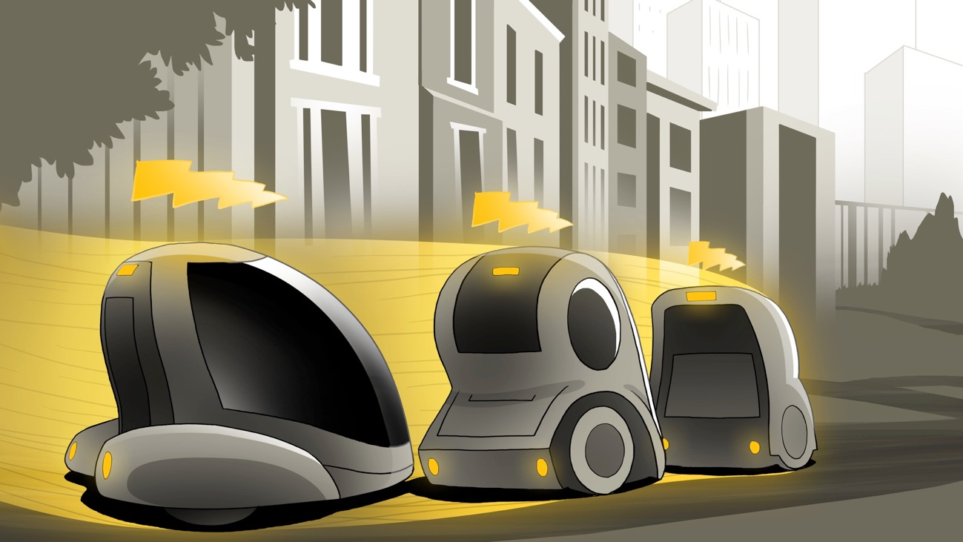
What is Platooning?
1:30
Notes:
Platooning: Volvo, Hyundai, Daimler-80,000 pound Freightliner

Slide 30
Denver’s congestion problem
Metro Denver growth: 3 to 4.1 million by 2040
Can we find billions to expand highways?
we struggle to find millions just to maintain them!
did adding lanes fix Los Angeles?
$2.06 billion: Current cost of metro area congestion
To find solutions, we must think out of the box
Sources: Colorado State Demographer, 2015 Urban Mobility Scorecard
Notes:
Nanotechnology, carbon fiber plastics, AI, Deep Learning

Slide 31
Why transit matters: Single-occupancy vehicles
Two hundred people clogging a street with their 177 cars
Source: International Sustainable Institute’s Commuter Toolkit poster

Slide 32
Business as usual won’t solve this problem
And they all would fit in one rail car, RTD’s largest and most efficient electric vehicle!
Source: International Sustainable Institute’s Commuter Toolkit poster

Slide 33
Source: U.S. Census Bureau, 2014
Notes:
Average commute into Denver is 25 minutes

Slide 34
We must reinvent public transit
True cost of bus service including subsidies
Farebox ratio | Local bus fare | Subsidy from taxes and grants | True “total cost” of a bus ride
0.21 | $2.60 | $9.78 | $12.38
Is there a better way to
deliver transit services for far less than $9.78 per passenger?
Notes:
When you look at fares versus total revenue, they are actually only 13.0% (much is for FasTracks buildout)

Slide 35
Eight RoboTaxi carpool rides can be provided for free for every $9.78 single bus ride subsidy, with $1.78 left over to provide free mobility-on-demand shuttle service to all light rail and subway stations.
Notes:
If you’d like more details…

Slide 36
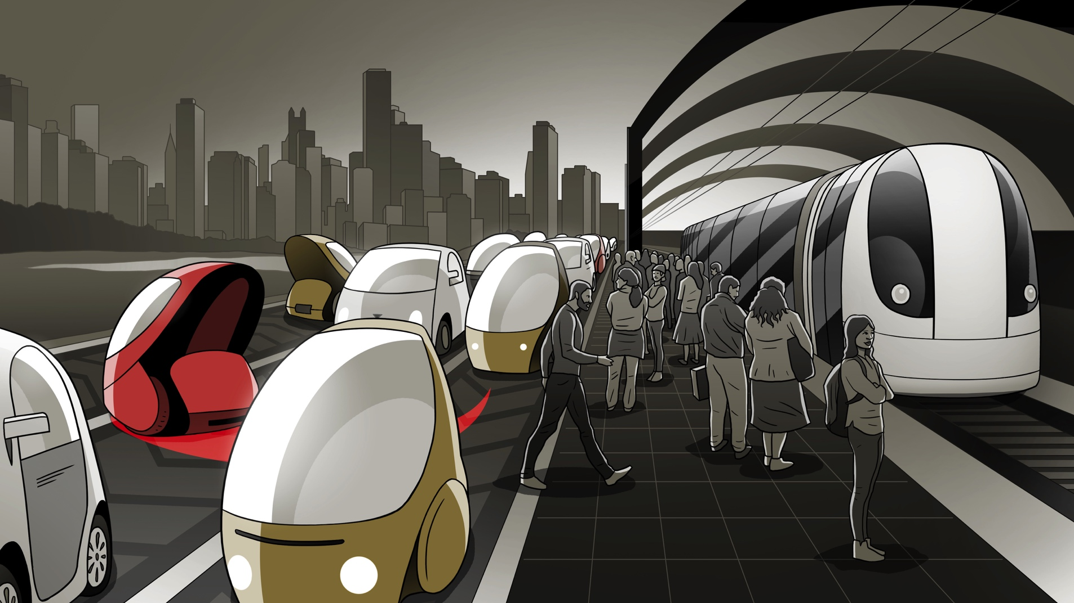
Coordinated door-to-door mass transit
Notes:
We need to reduce congestion and maximize the investment
in light and heavy rail by driving up ridership while reducing total travel time.

Slide 37
Not if, but when…
The transition will be economically challenging
How quickly can companies adjust their business models?
Consumer savings = economic stimulus, new jobs
But millions of workers will lose good jobs

Slide 38
First driverless availability?
True Level 4 Autonomous Cars
nuTonomy: 8/25/16 | Ford: 2021
Tesla: 2018 | Volvo/Uber: 2021
Google: 2019? | BMW/Baidu: 2021
Issues: Regulation, snow, heavy rain/fog/dust, maps
Notes:
First availability: Not in Denver (snow), initially limited, geofenced due to map needs

Slide 39
Adoption Rate?
Notes:
If you’d like more details…

Slide 40
Millennial survey (415 sample, ages 18-35)
How much do you know? 80% = a little or very little
Try test ride? 42% ready now, 26% if used in other states and proven safe, 11% if I knew someone using them
After describing features: Would you use a RoboTaxi service? 46% Definitely, 41% Probably
If you have a second car, would you consider replacing it with a RoboTaxi service? 51% Yes, 49% No
Notes:
Personally-owned vehicles are usually parked about 94% of the time

Slide 41
New business models can be just as disruptive as new technologies. Note how fast have Uber and Lyft expanded, and how slowly taxi companies responded…

